Slide 1
Design Development
Digital Forensics Solution using a Multi-Agent System (MAS) Decentralized Architecture
Prepared by RMRK Consultants
Notes:
Talking through the code
Talking through the implementation
How I have created what I have created (why and the how)

Slide 2
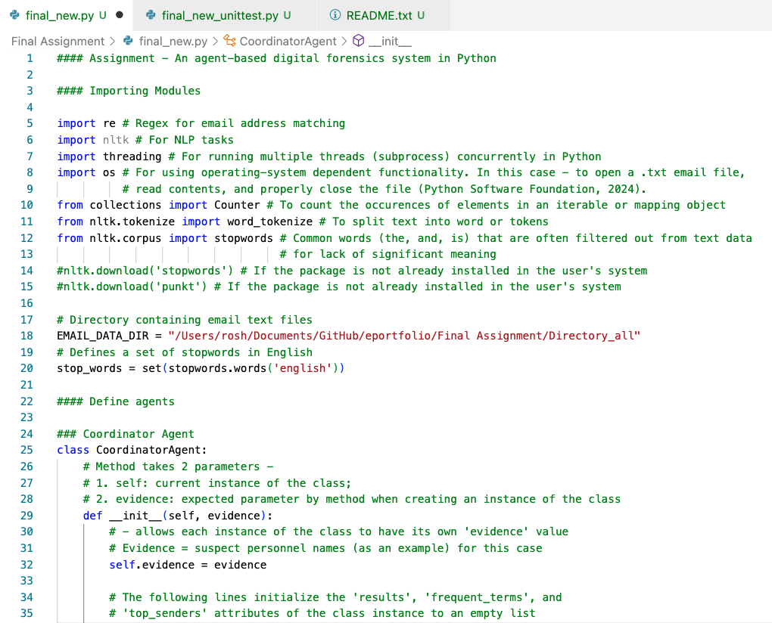
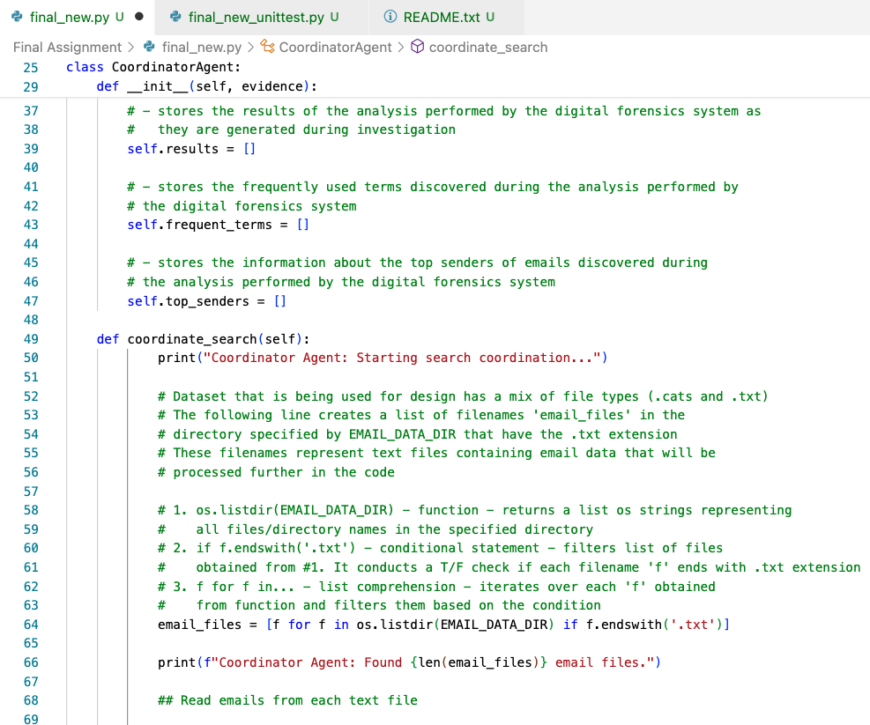
Code Functionality

Slide 3
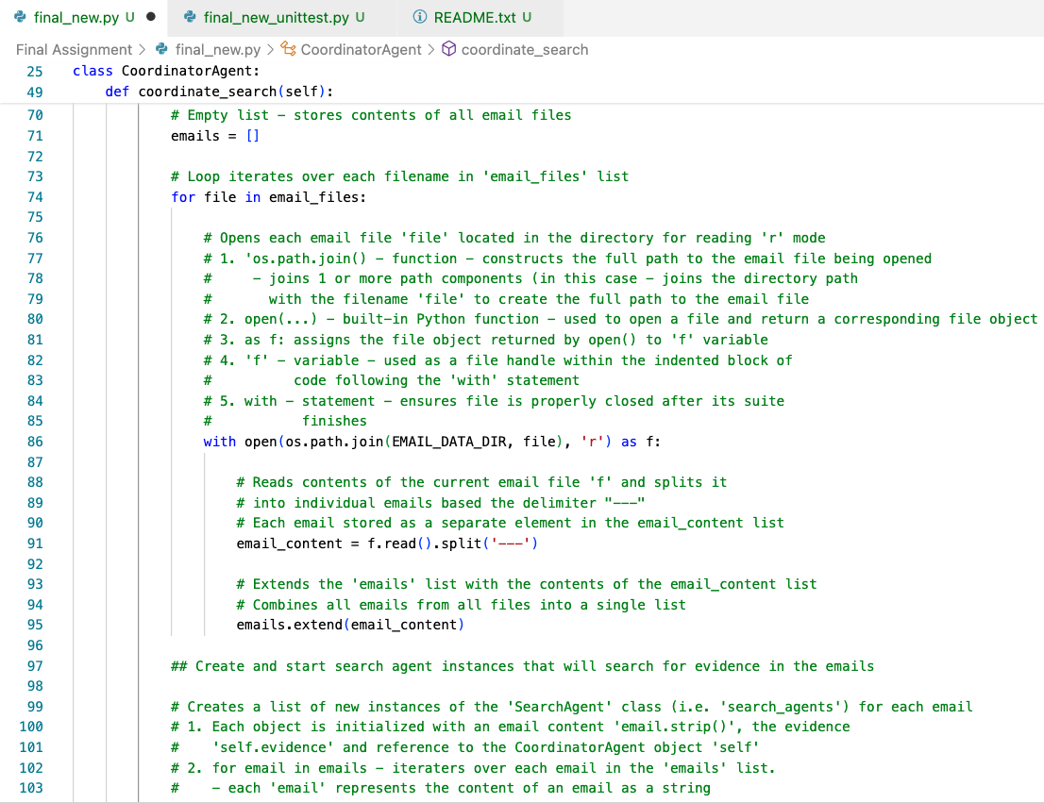
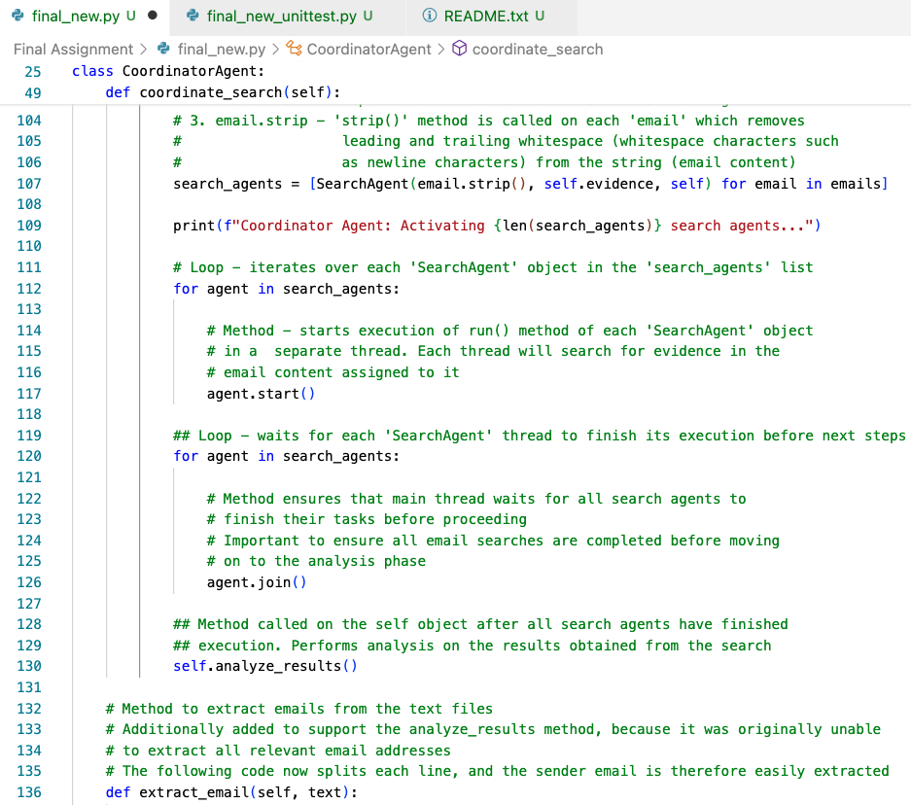
Code Functionality (continued)

Slide 4
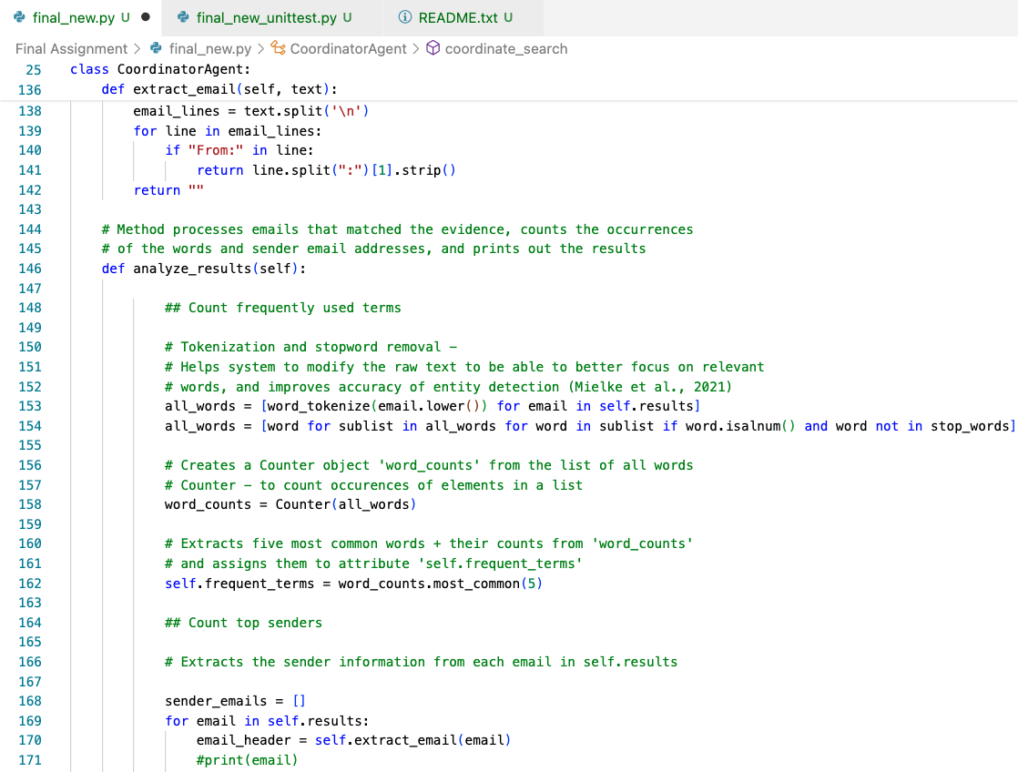
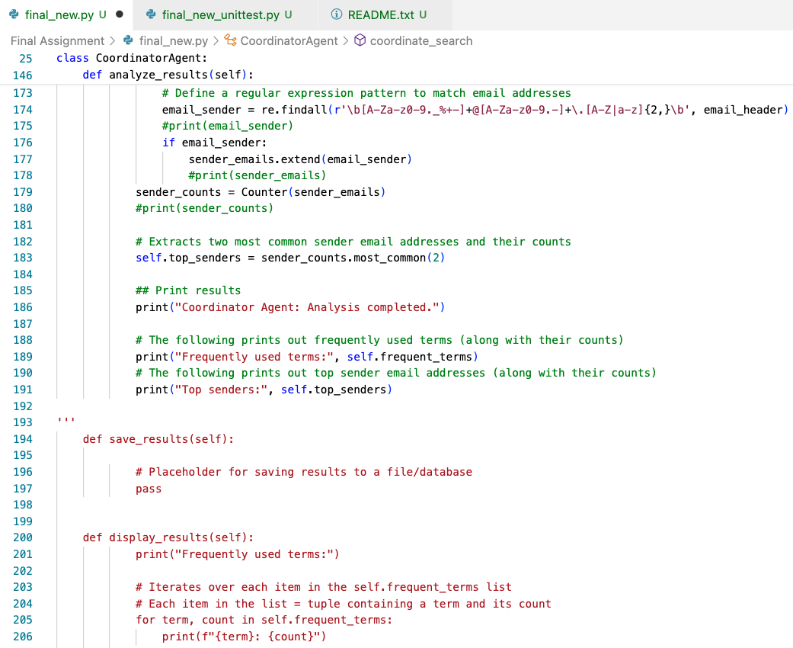
Code Functionality (continued)

Slide 5
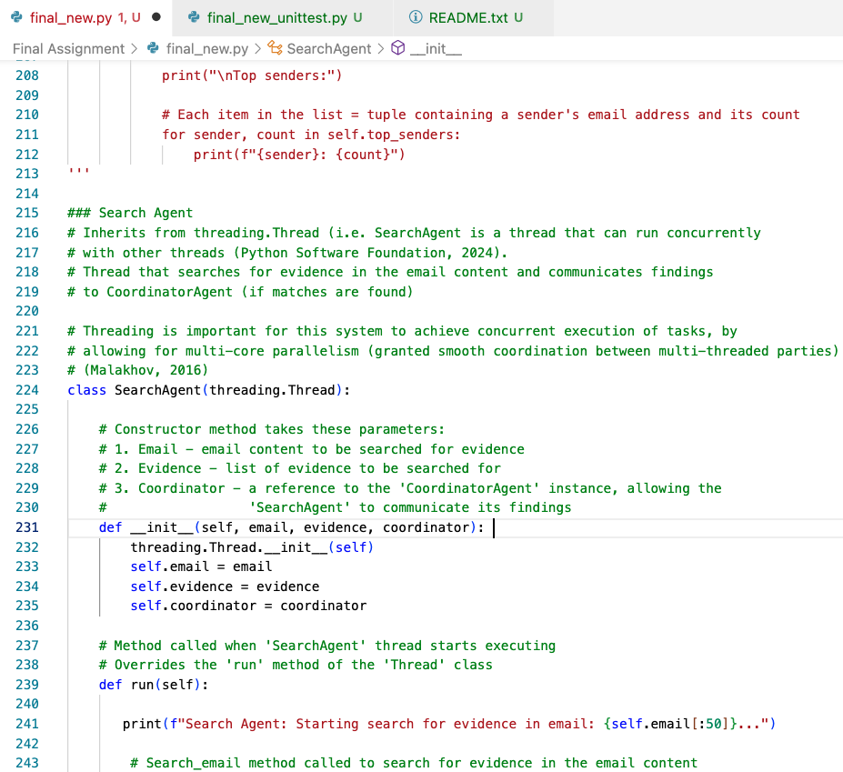
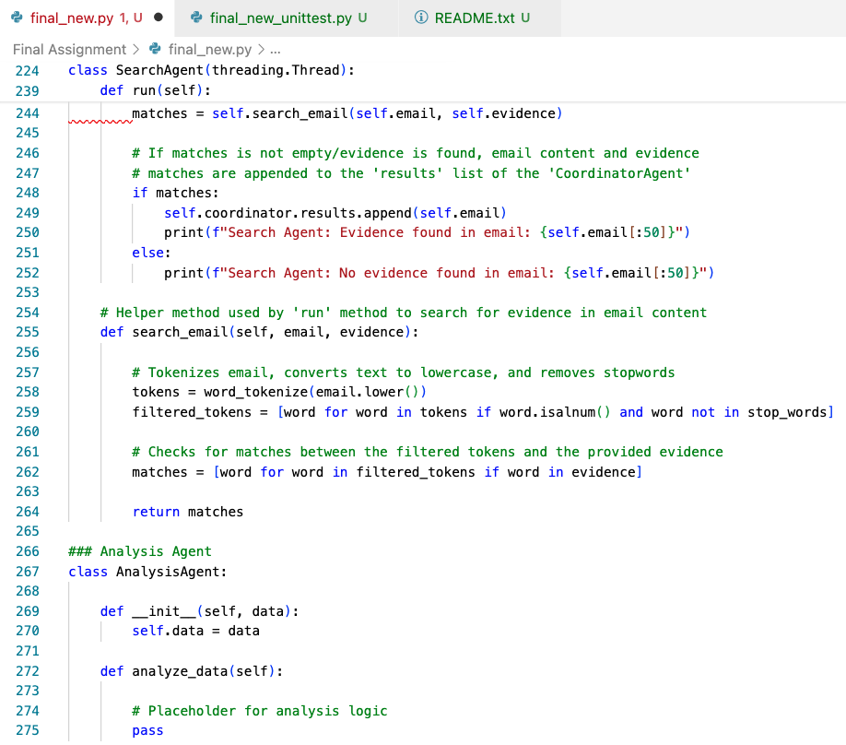
Code Functionality (continued)

Slide 6
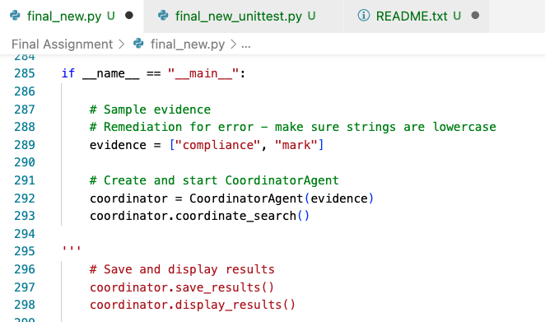
Functional Testing

Slide 7
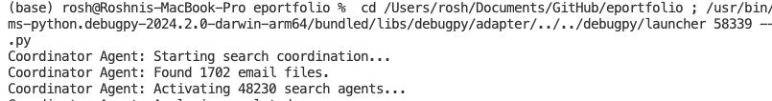
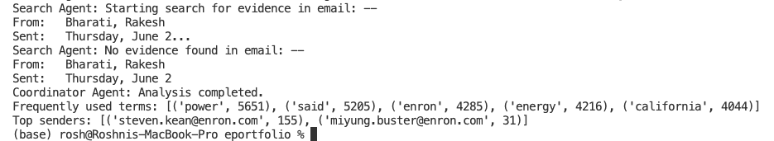
Output
Dataset: Cohen, W. (2015) Enron Email Dataset. Available from: https://www.cs.cmu.edu/~enron/ [Accessed 28 February 2024].

Slide 8
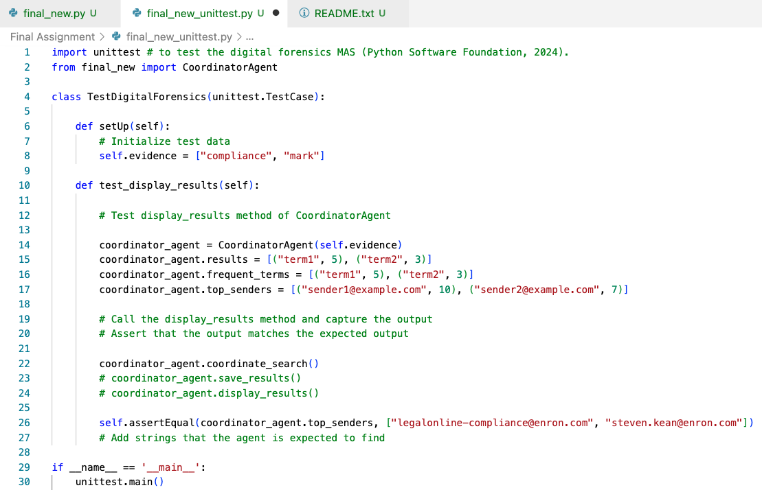
Unit Testing

Slide 9
Summary
MAS decentralized architecture designed in Python to be a digital forensics solution for Enron Corporation’s legal team to help identify company individuals involved in suspected illegal activity
The actor (herein Enron corp) can enter suspect names or categories as evidence (for a particular dataset) within the MAS, which will be used to search emails, and produce:
Frequent terms used within the respective emails, and
Top senders of those emails
Outputs in the user interface aid in understanding agent activity within the MAS
README file discusses testing of the system with any particular dataset

Slide 10
Thank you!

